Slide 1


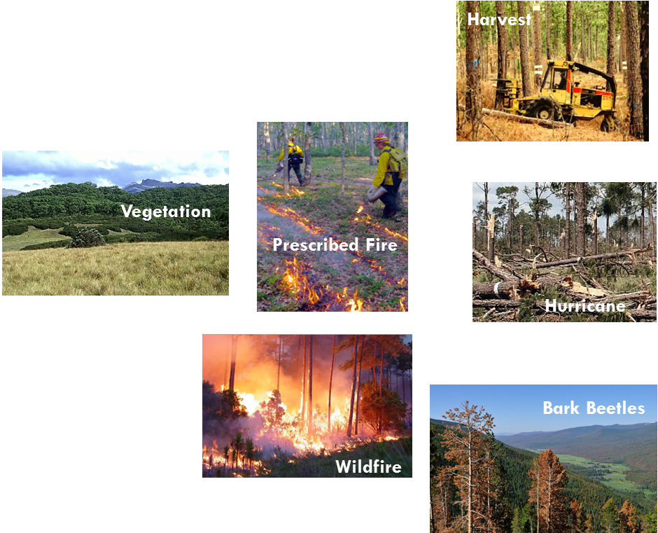
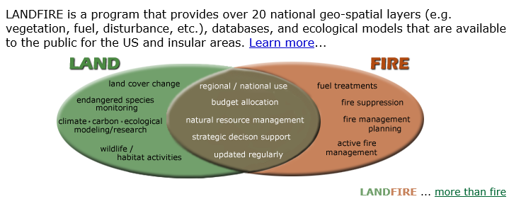
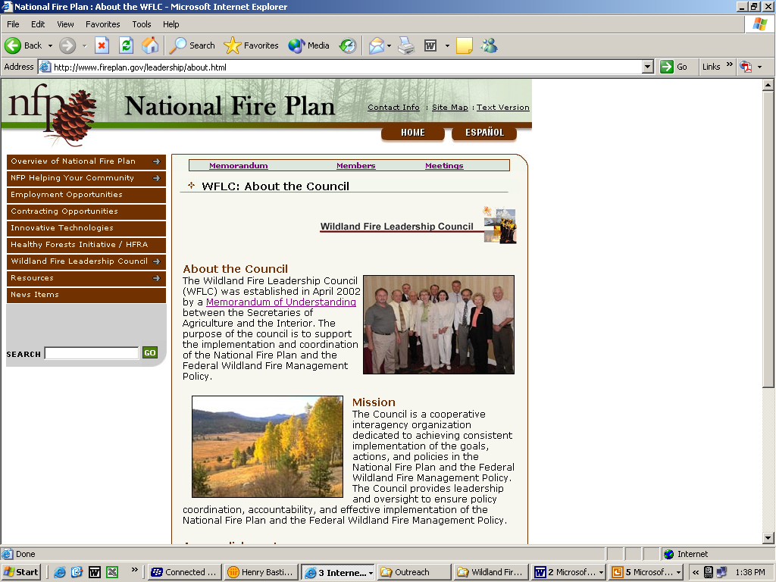
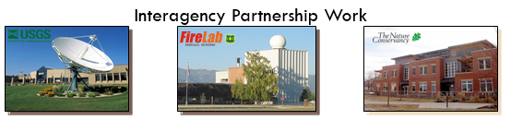
NE – Wildland Fire Management Tools – Fall 2020:
AGENDA:
What is it?
Why it’s important
Budget (use and not used)
NE Remap and future
LANDFIRE
Landscape Fire and Resource Management Planning Tools Project
  Comprehensive
  Consistent
  Compatible
  Current

Slide 2
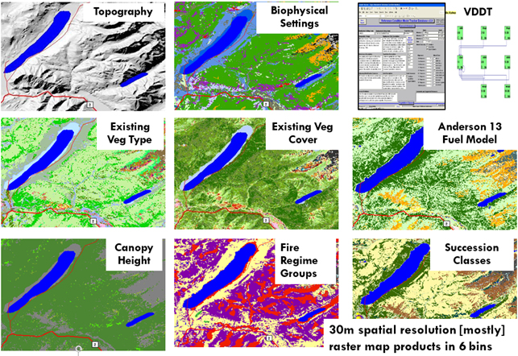
Products (Spatial and Non-spatial)
What is it?
BRIEF DESCRIPTION: LANDFIRE - Landscape Fire and Resource Management Planning Tools, is a multi-partner program producing consistent and comprehensive geospatial data and databases describing vegetation, wildland fuel, and fire regimes for all lands regardless of ownership. LANDFIRE provides a common "all-lands" data set of biological/ecological data for vegetation, land cover, biophysical and wildland fire and fuels data (30 meter pixel geospatial data and databases) across all 50 states and territories.
Human/Natural
Disturbance (4+)
Current Vegetation Type, Height Cover (3)
Potential Vegetation (2)
Surface/Canopy Fuels (8)
Pre-European Fire
Regimes/Vegetation
Departure (7)
Elevation (3)
Notes:
LANDFIRE produces both spatial and non-spatial data such as vegetation, disturbances, fuels, and state-and-transition models.
Images:
Representative data products of vegetation, disturbances, fuels, and database.

Slide 3
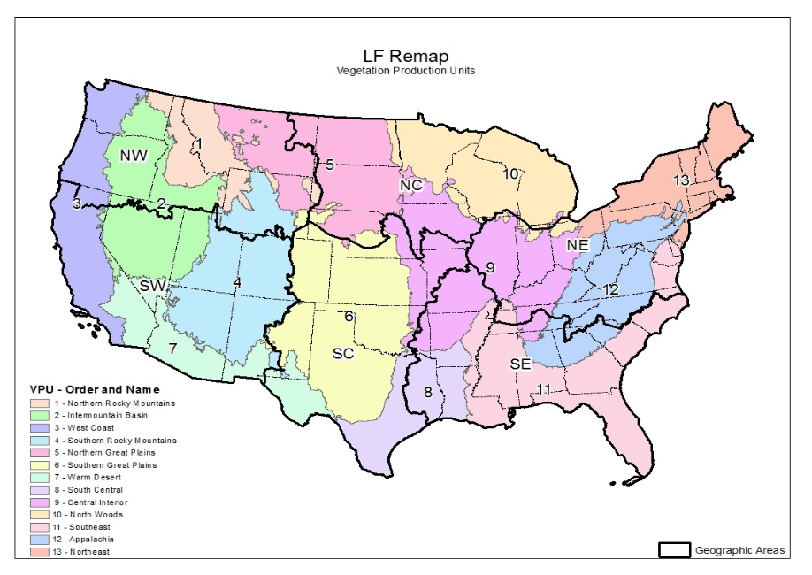
What is it?
LF Remap Work

Slide 4
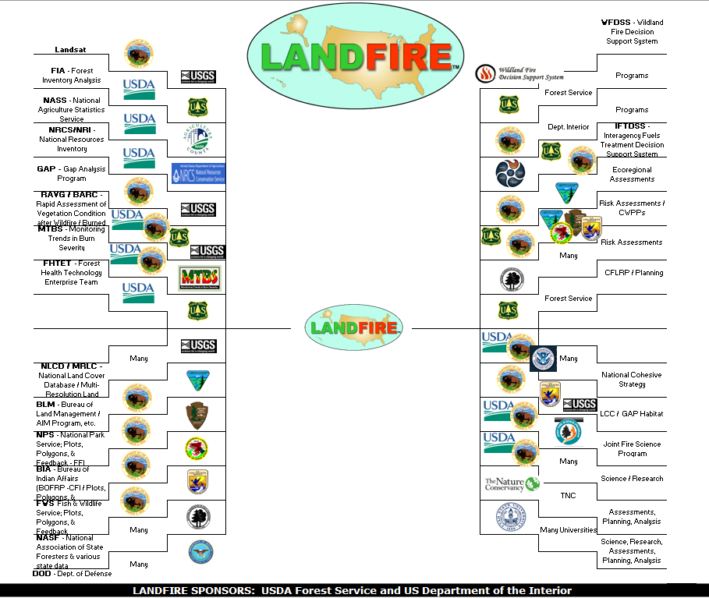
LF – Data Providers & Data Consumers
What is it?

Slide 5
LF - Remap Improvements
What is it?
Process Improvements 4 major areas:
  Unlimited access to the Landsat archive
    Better imagery – image composites, fewer seamlines,
    Better map (water, barren) and modeling masks (riparian, alpine)
  Vegetation Structure and Lifeform
    Improved plot selection, better base imagery, lidar inputs -> continuous structure
  Existing Vegetation Type – Recently disturbed, WUI, New and improved auto-keys – expert review and feedback
  Improved processes – refined production units… more training data (partnerships)

Slide 6
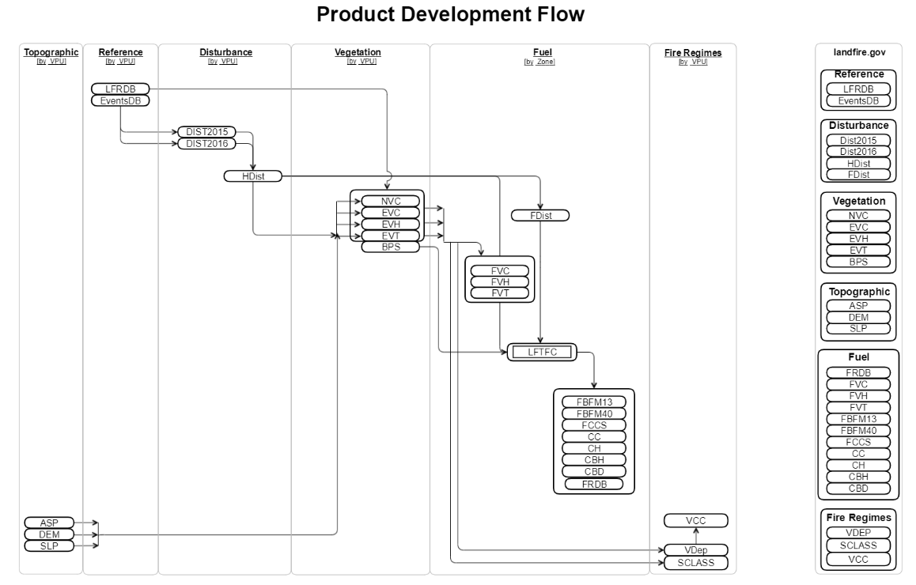
Data processing (ground plot data with remote sensing data).
Production Flow Chart
What is it?

Slide 7
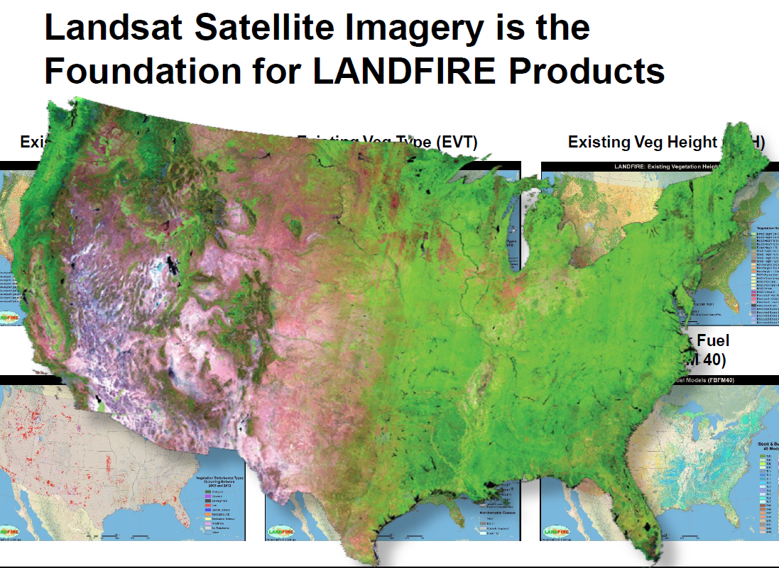
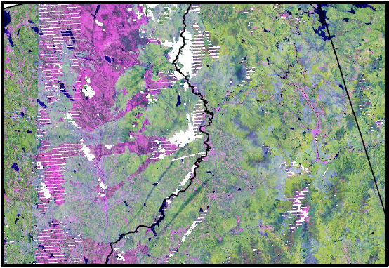
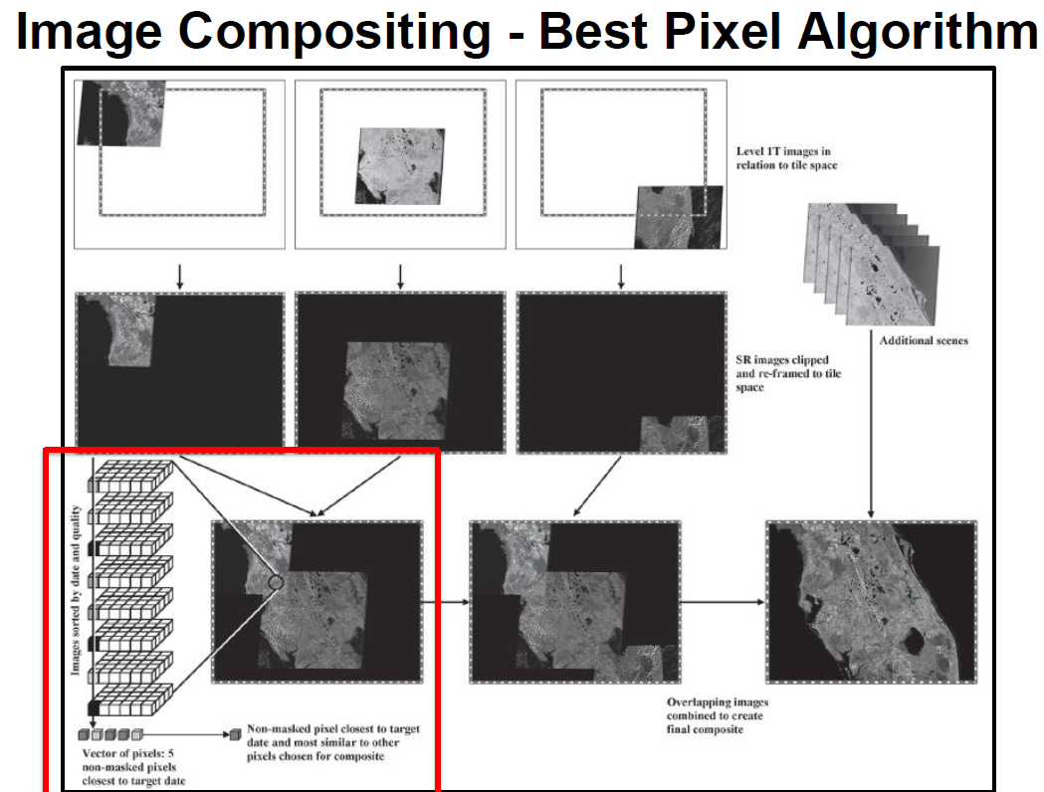
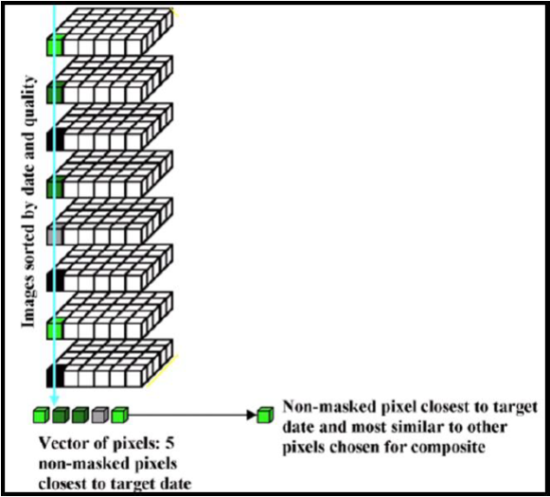
What is it?
Notes:
“Ugly Composites”
•In certain geographies composites are
difficult to produce
–Lack of cloud-free pixels
–Phenology differences

Slide 8
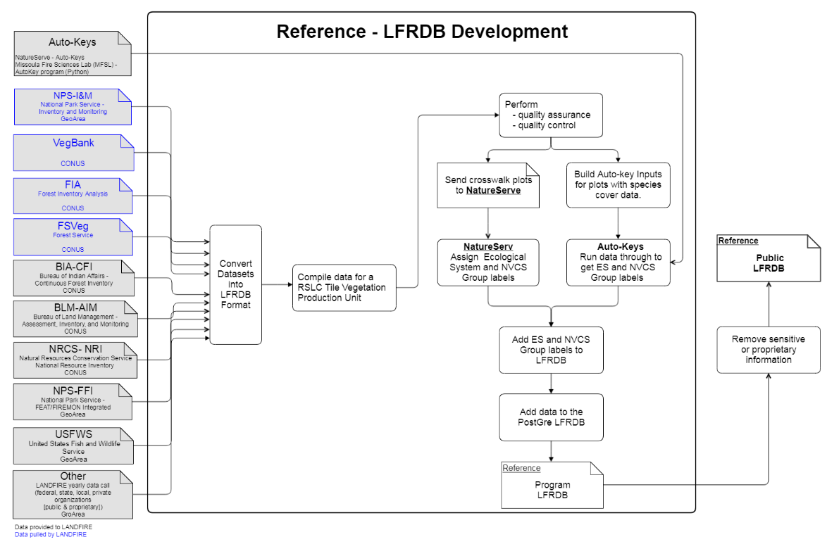
LANDFIRE Reference Database (LFRDB)
What is it?

Slide 9
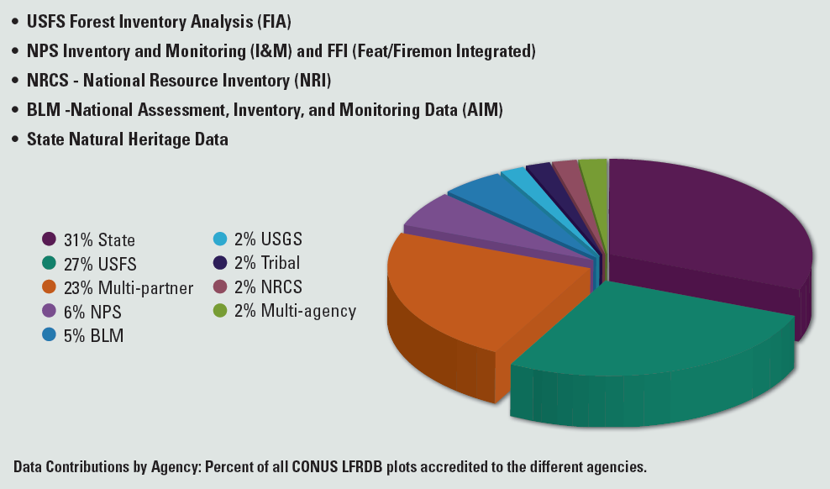
LF Reference Database (LFRDB) –
Data Contributions
(775 Sources; Over 1 Million Plots)
What is it?

Slide 10
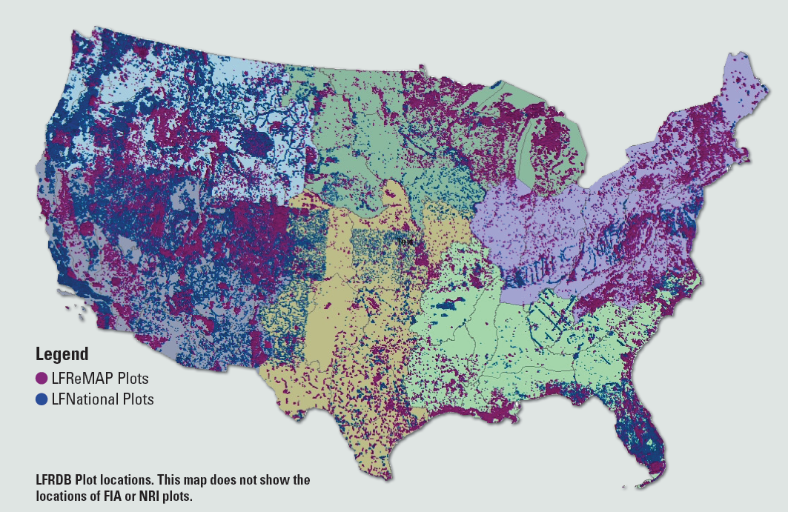
LFRDB Plot Distribution (National to ReMap)
What is it?

Slide 11
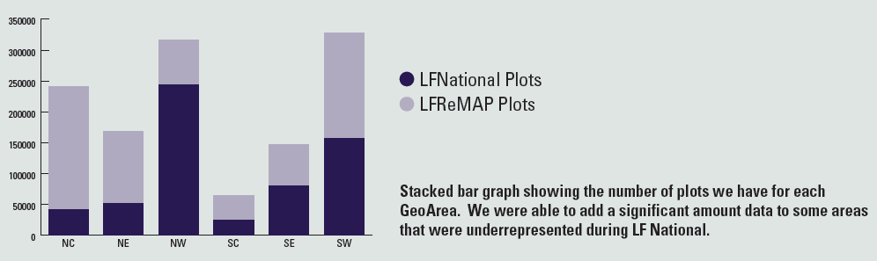
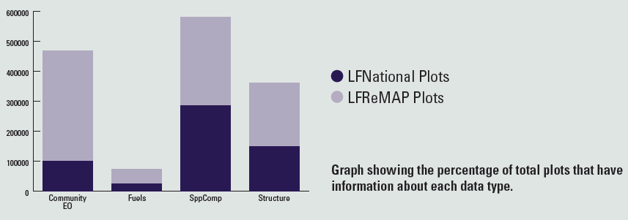
LFRDB Plot Numbers (National to ReMap by GeoArea)
What is it?
LF – LFRDB Plot Type (Species Composition, Structure, Occurrence, & Fuels)

Slide 12
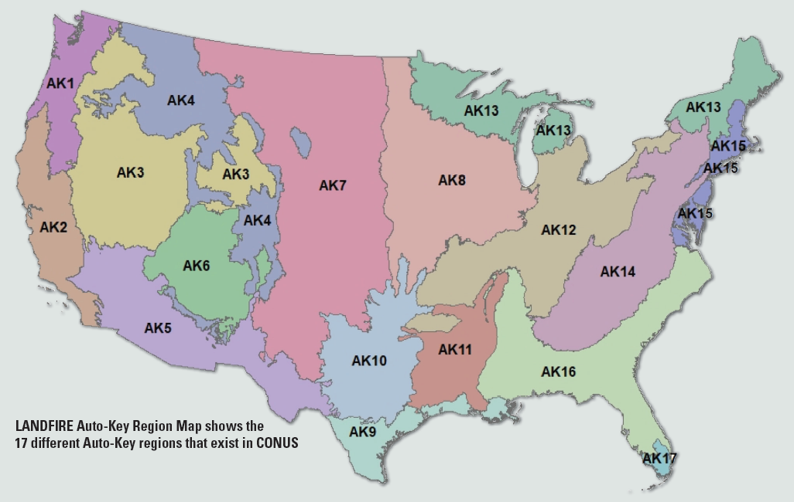
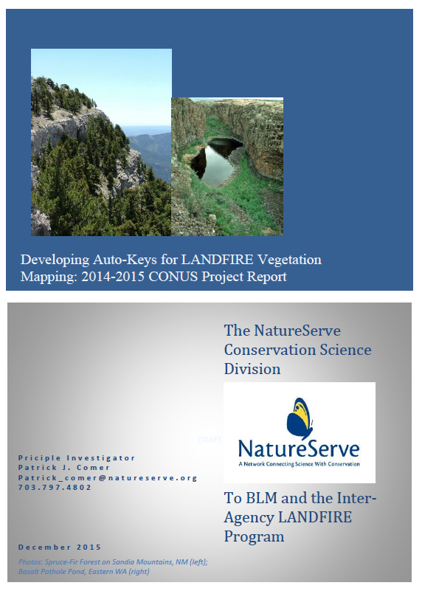
LF – Auto Keys (NatureServe – Regions)
What is it?

Slide 13
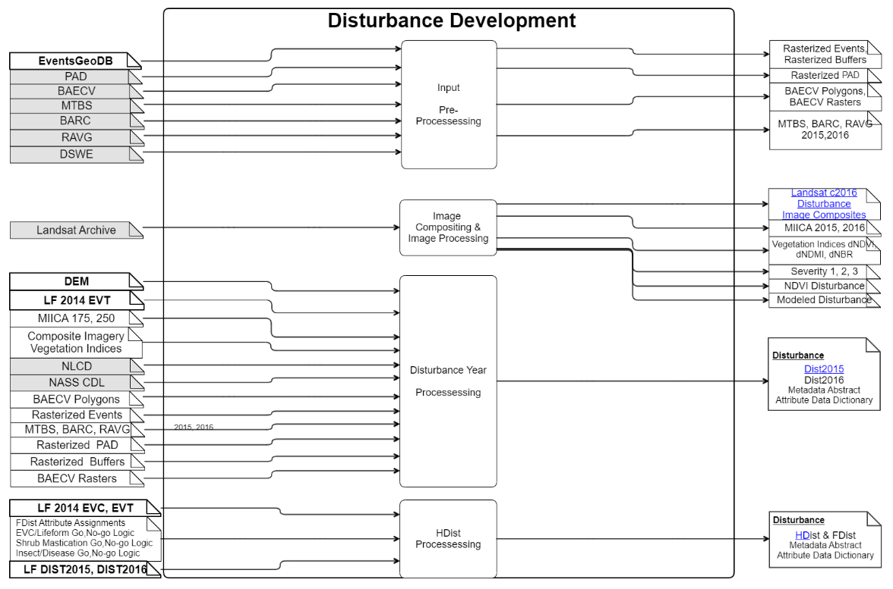
LF – Disturbance Production Flow
What is it?

Slide 14
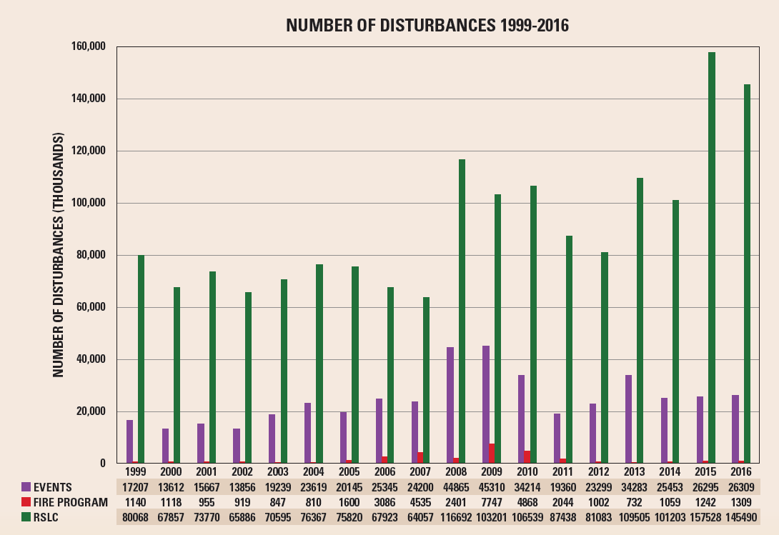
LANDFIRE Disturbance Mapping
What is it?

Slide 15
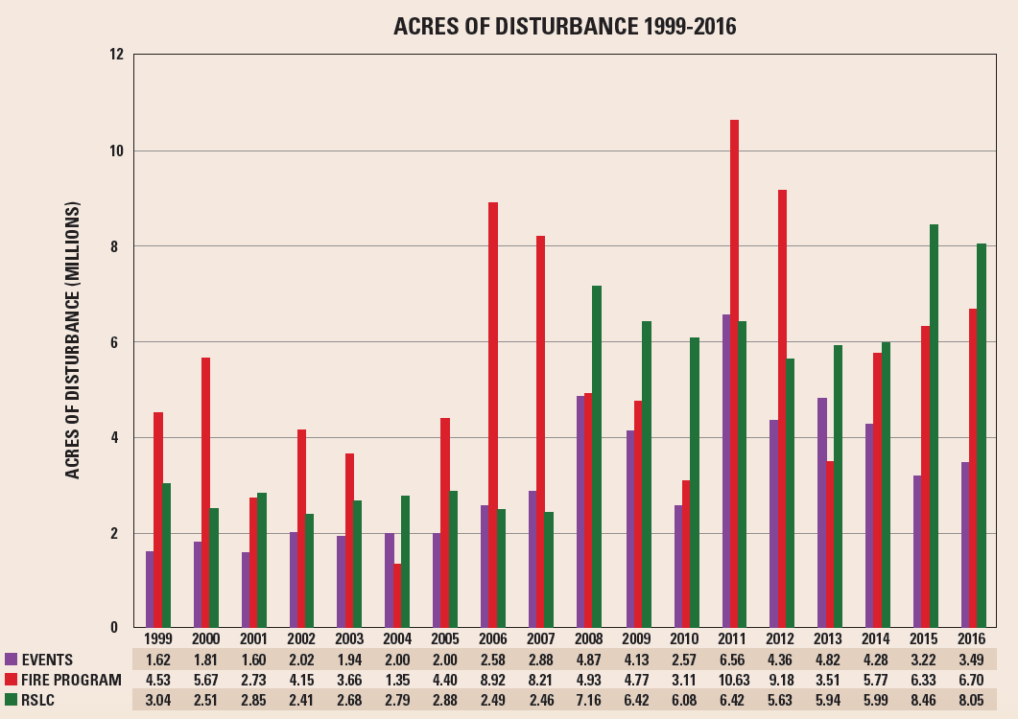
LANDFIRE Disturbance Mapping
What is it?

Slide 16
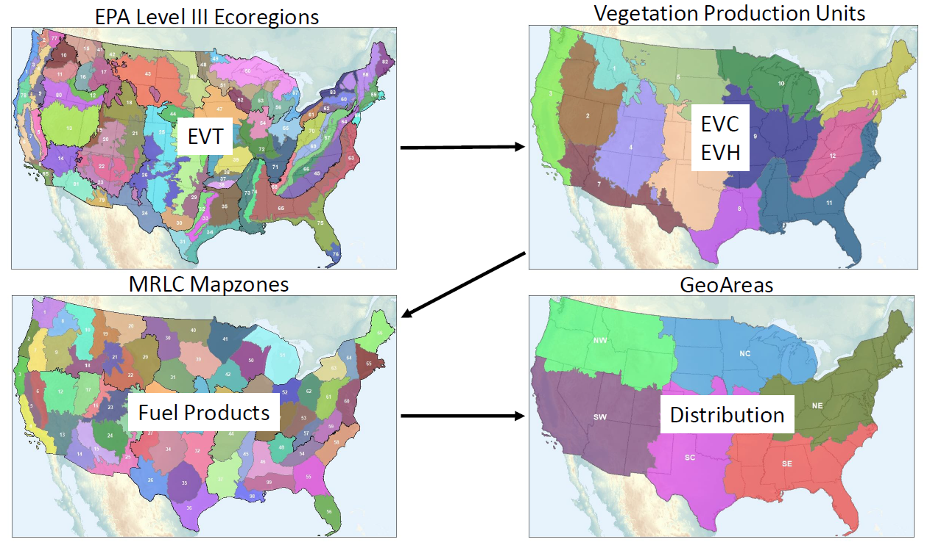
Mapping Methods
Existing Vegetation Cover (EVC) and Existing Vegetation Height (EVH)
What is it?
Continuous data (10-100m)
Model
  Regression Tree using CUBIST algorithm
  Boundary: aggregate of EPA Level III Ecoregions (Vegetation Production Units) {Omernick}
  Independent variables
    Landsat seasonal composites for Spring, Summer, Fall, and Winter
    tasseled-cap
    temporal NDVI (5-year maximum, minimum, median, and max-median)
Training data
  LANDFIRE Reference Database (LFRDB) plots
  LiDAR
  NLCD fractional vegetation
Masks
  lifeform (tree, shrub, herb)
  barren and sparse vegetation
  other classes (agriculture, developed land,
  roads, water, ice/snow)
Classification (Legend)
  Ecological Systems
  National Vegetation Classification System

Slide 17
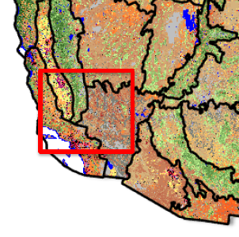
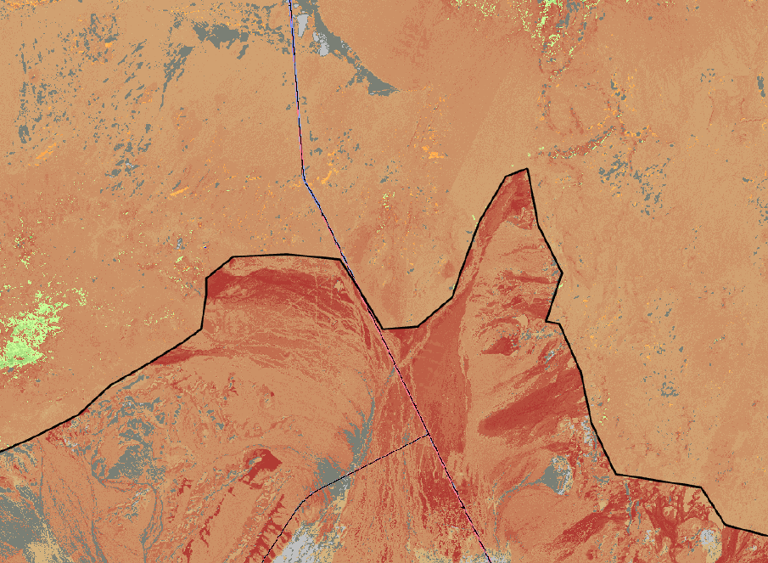
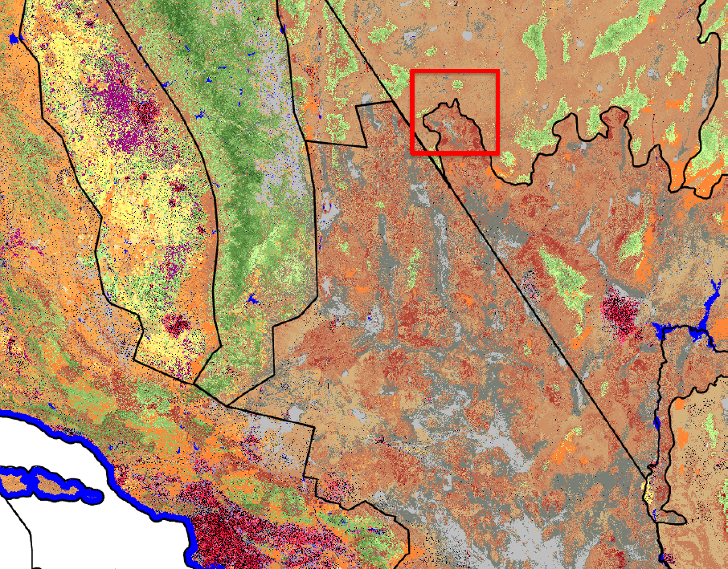
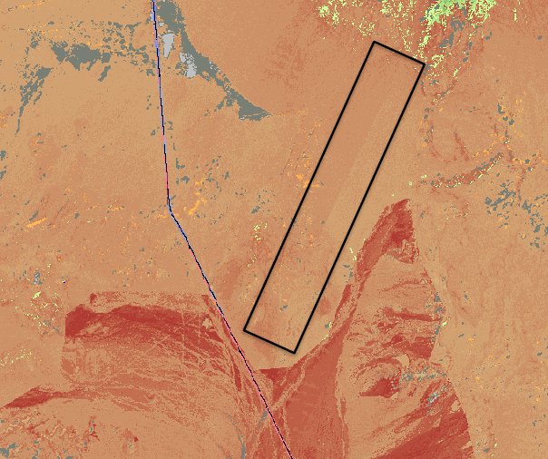
LF –2014 Existing Vegetation Cover (EVC) by map zone
CA/NV State Line

Slide 18
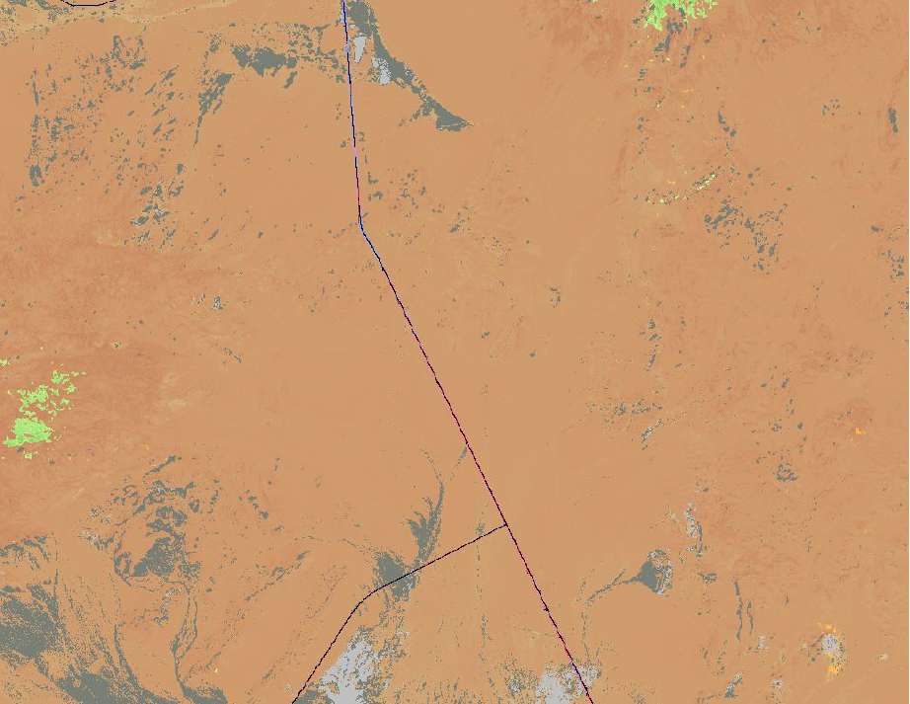
LF 2016 Remap - EVC

Slide 19
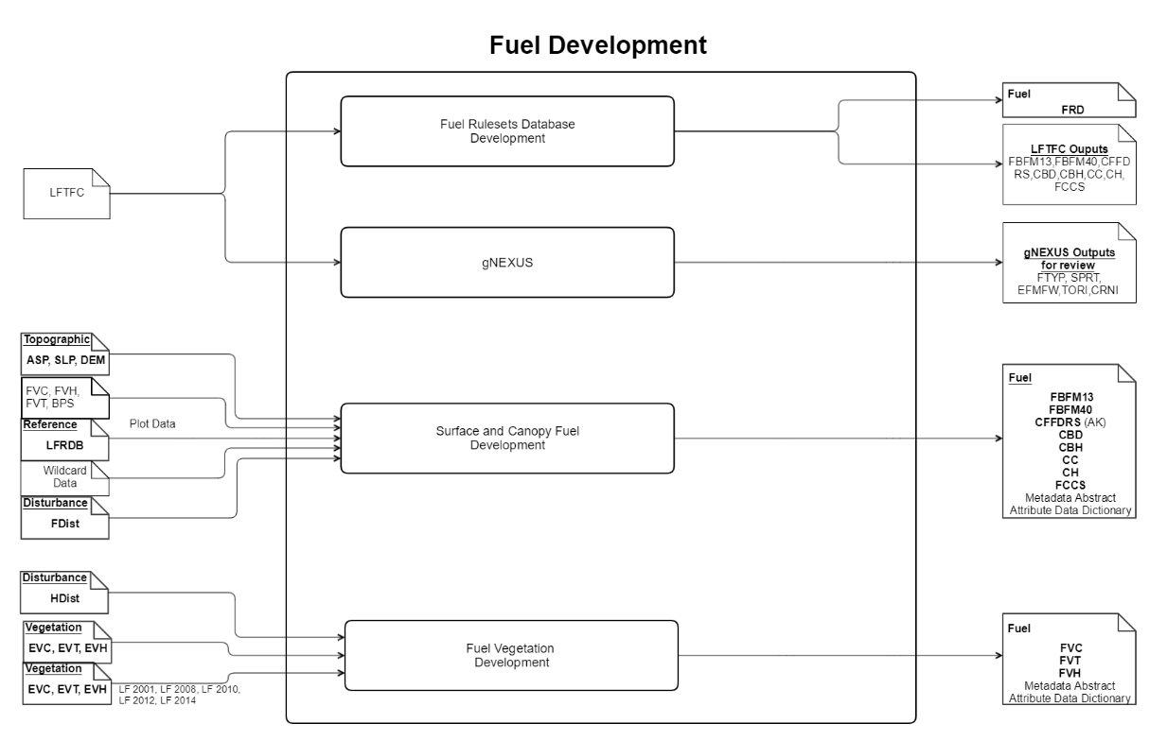
LF – Fuel Production Flow
What is it?

Slide 20
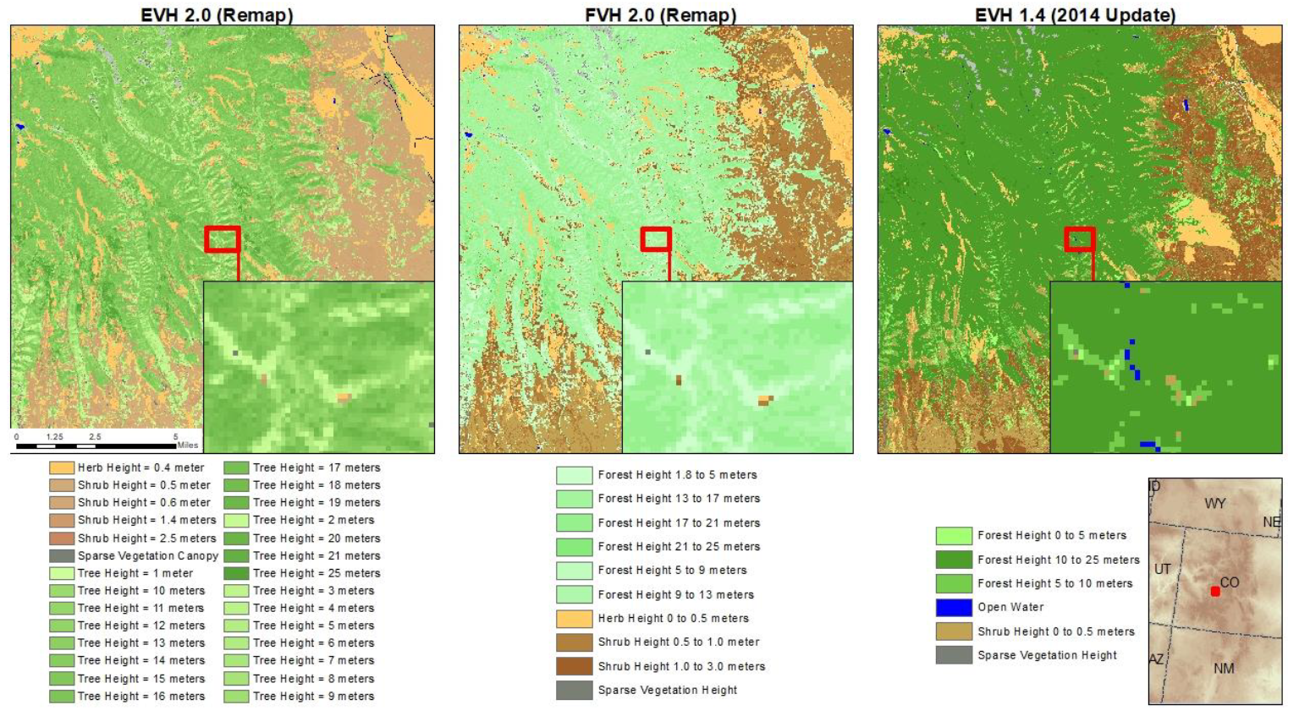
Compare Existing Vegetation and Fuel Vegetation
Example – Existing Vegetation Height (EVH) and Fuel Vegetation Height (FVH)

Slide 21
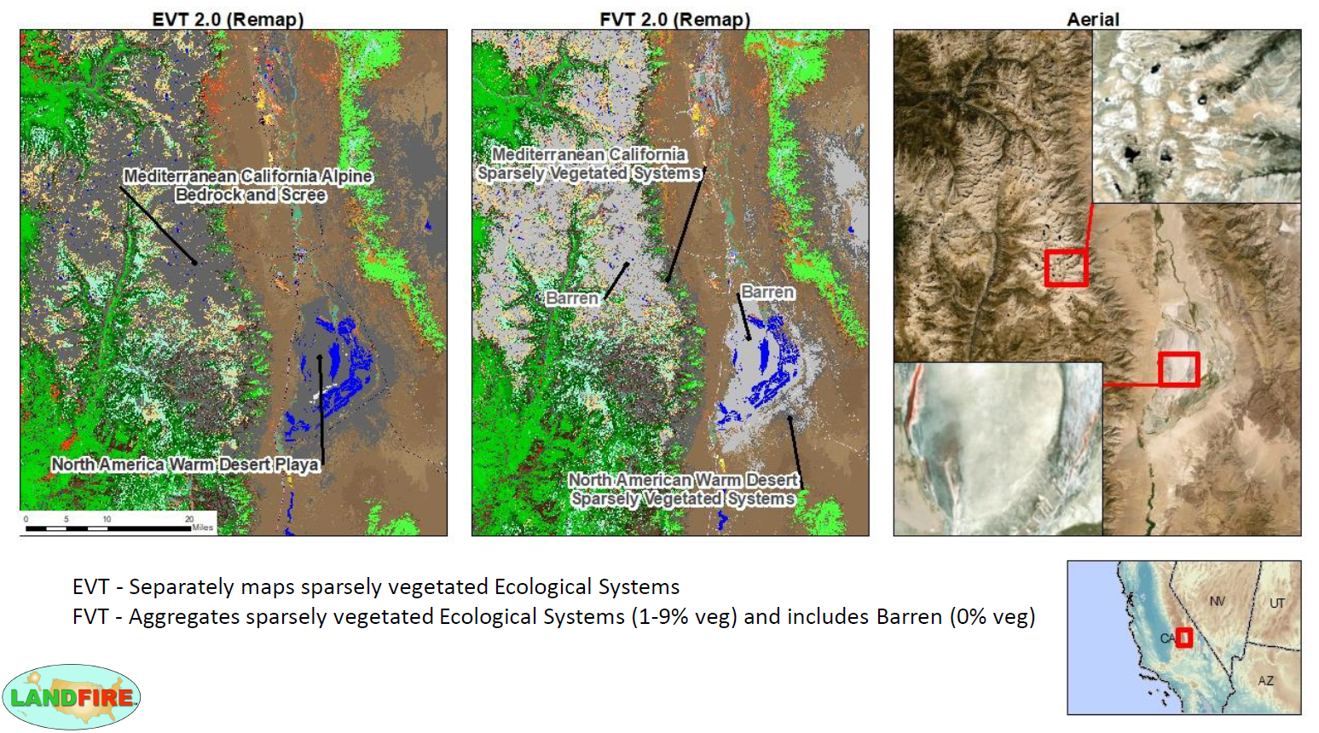
Compare Existing Vegetation and Fuel Vegetation
Example – Existing Vegetation Type (EVT) and Fuel Vegetation Type (FVT)

Slide 22
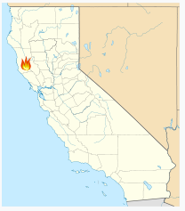
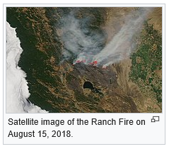
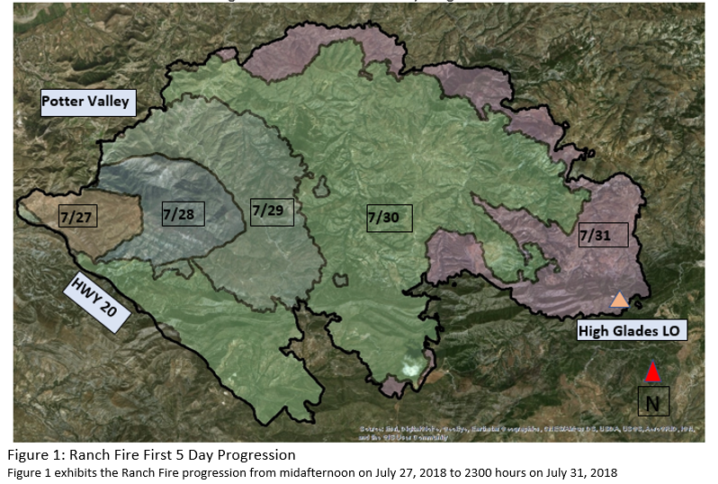
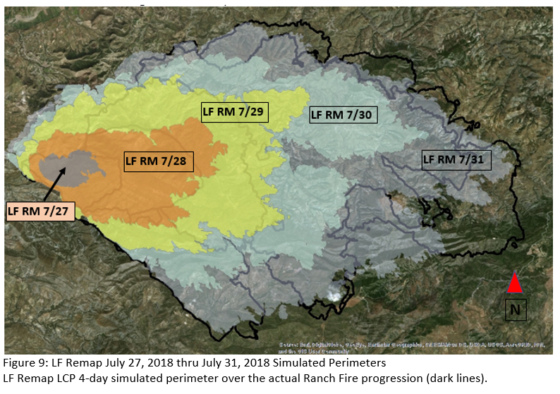
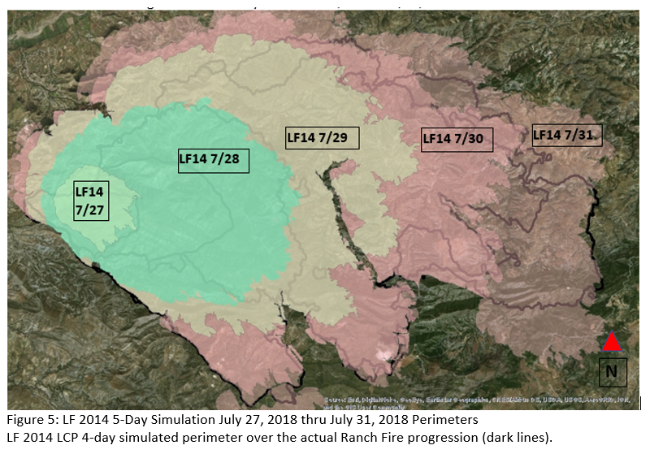
Ranch Fire – CA.

Slide 23
LF – Data Providers & Data Consumers

Slide 24
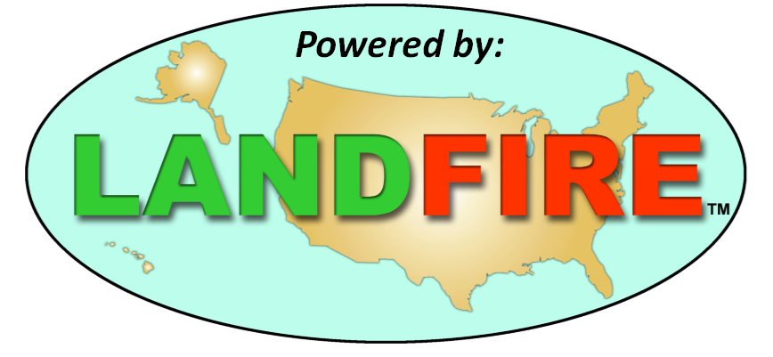







Why is it
Important?
POWERED BY LANDFIRE . . . . . . . . . . WFDSS, IFTDSS, FMSF, landscape assessment, analysis, research, planning, monitoring, management, restoration/rehabilitation, performance measures, and provides key data for risk mapping and hazard analysis that are critical for wildland fire management.
Data to provide information for fire projections with elements such as:
- what the flame lengths may be,
- what the fire rate of spread may be,
- how the fire progression might play out on the landscape,
- fire probability information on where fires will reach locations across a landscape,
- when a fire would transition from a surface fire to a crown fire (e.g. height to live crown)

Slide 25
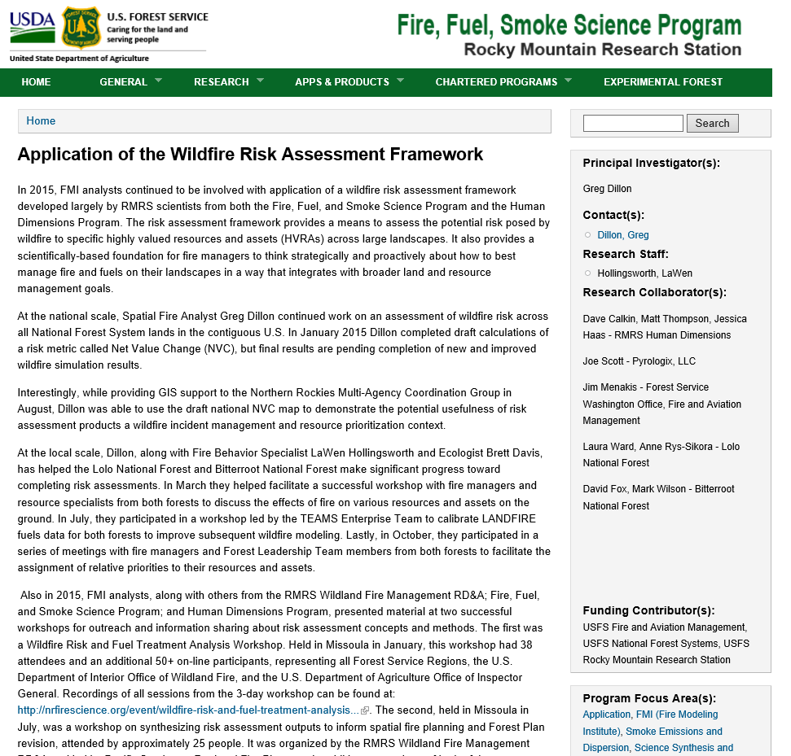
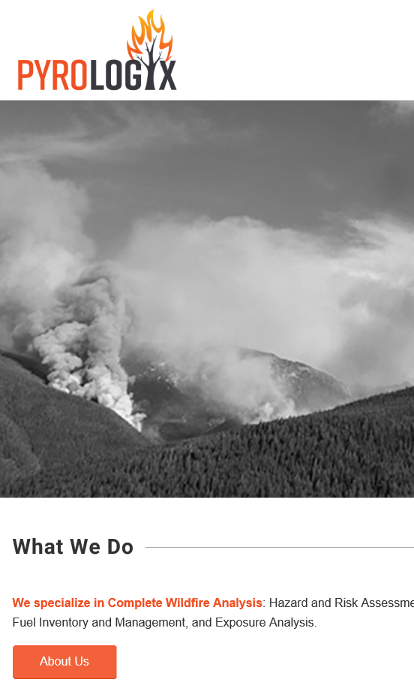
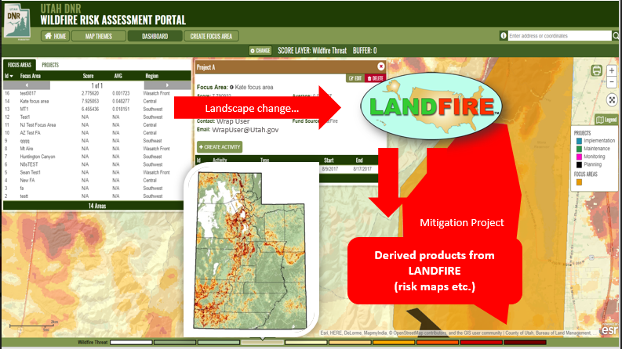
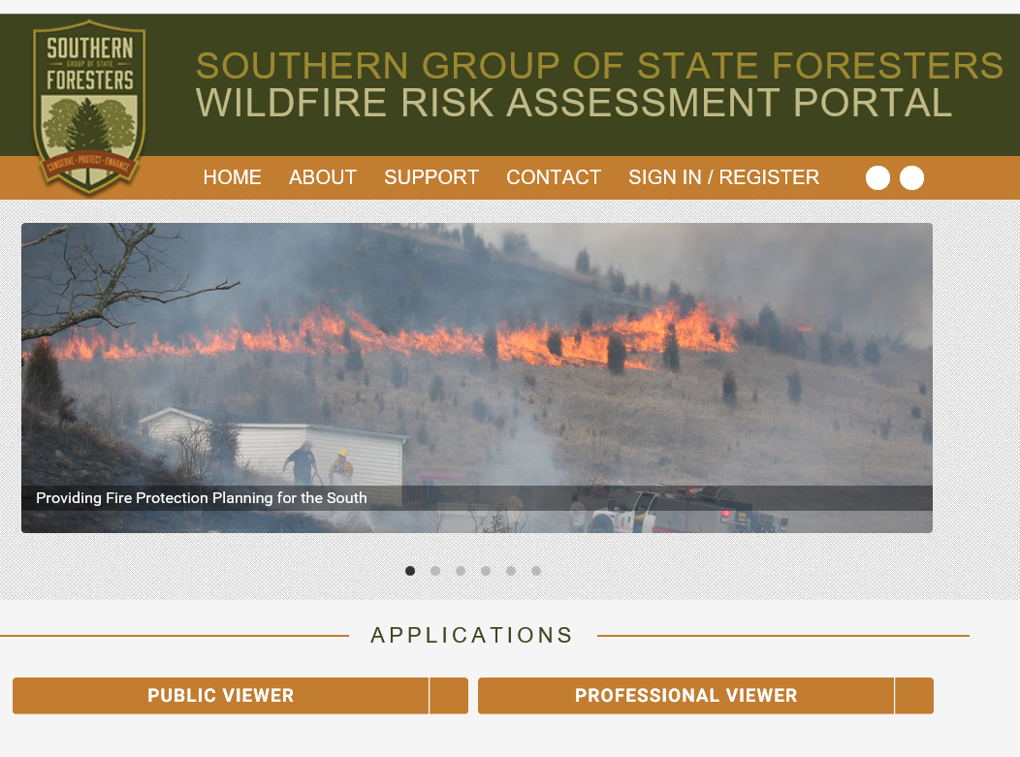
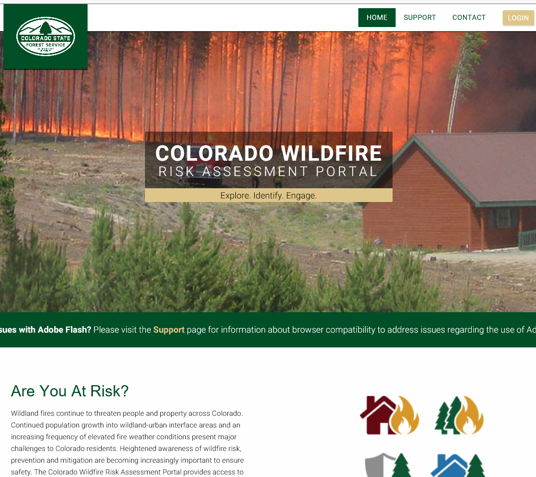
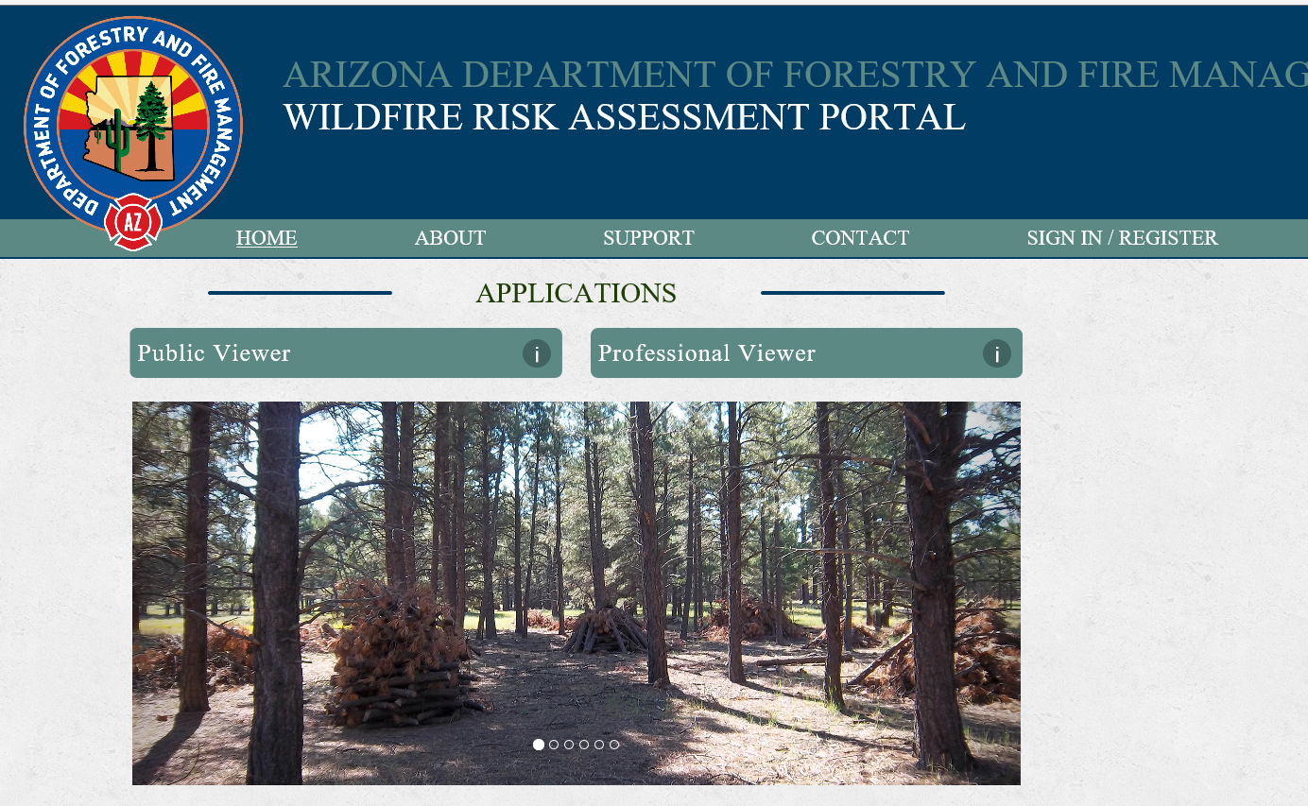
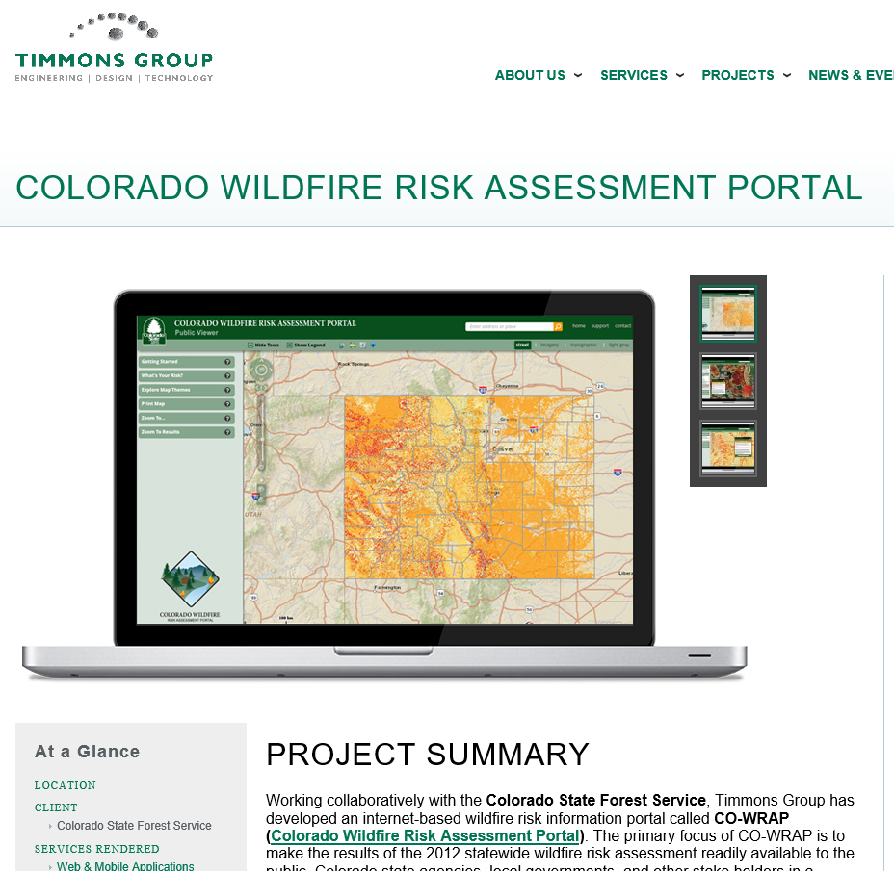
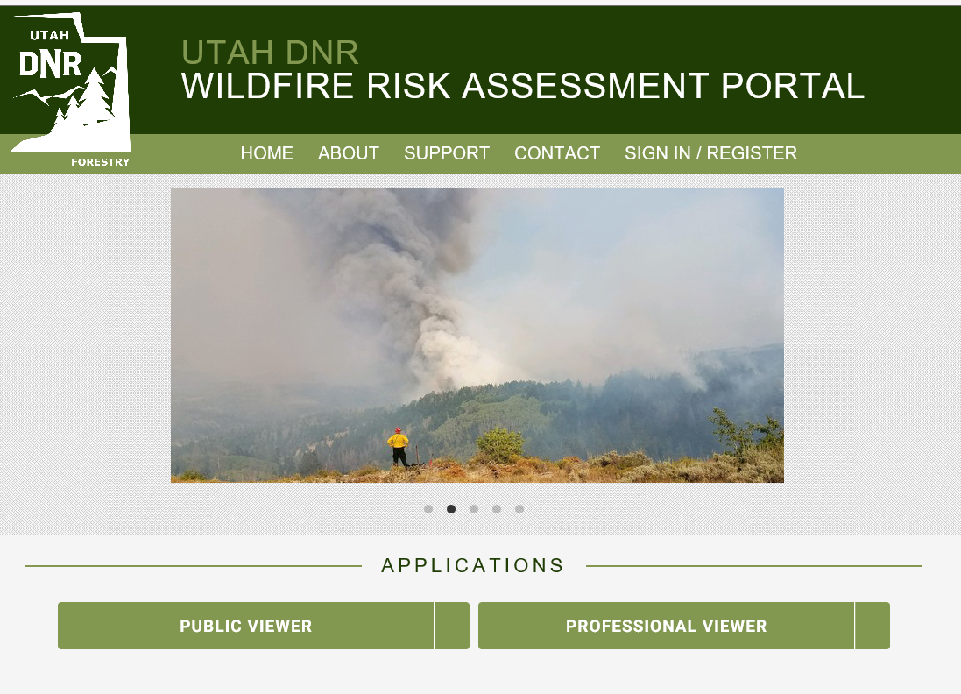
Risk Assessments . . . .
Why is it
Important?

Slide 26
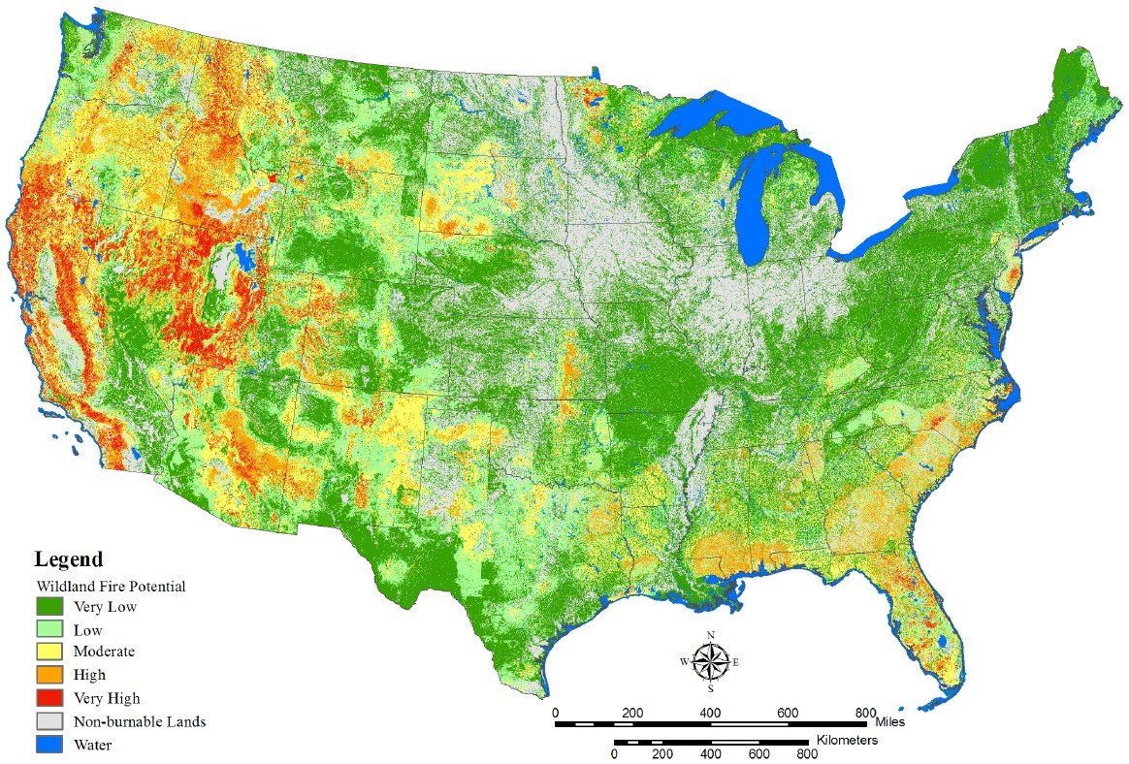
Data Use Examples – Wildfire Hazard Potential
Why is it
Important?
Wildfire Hazard Potential
Relative potential for wildfire
Difficult to contain fires (past fire occurrence)
Higher WFP values = increased probability of high-intensity fire
LANDFIRE data provides canopy height, canopy cover, and canopy base height (critical data for this analysis).
Notes:
Wildland Fire Potential (WFP) based on past fire occurrence and estimates of wildfire likelihood with higher WFP values representing fuels with an increased probability of high-intensity fire across the conterminous U.S. using LANDFIRE data (canopy height, canopy cover, and canopy base height, existing vegetation type and shrub canopy cover) for use to define locations with crown fire potential.
Difficult to contain fires, based on past fire occurrence and estimates of wildfire likelihood
Higher WFP values represent fuels with increased probability of high-intensity fire
LANDFIRE data . . . . . . of canopy height, canopy cover, and canopy base height, . . . . . . . are critical data to do this analysis.
Images:
Map of the conterminous United States showing the distribution of wildland fire potential (from very low to very high).

Slide 27
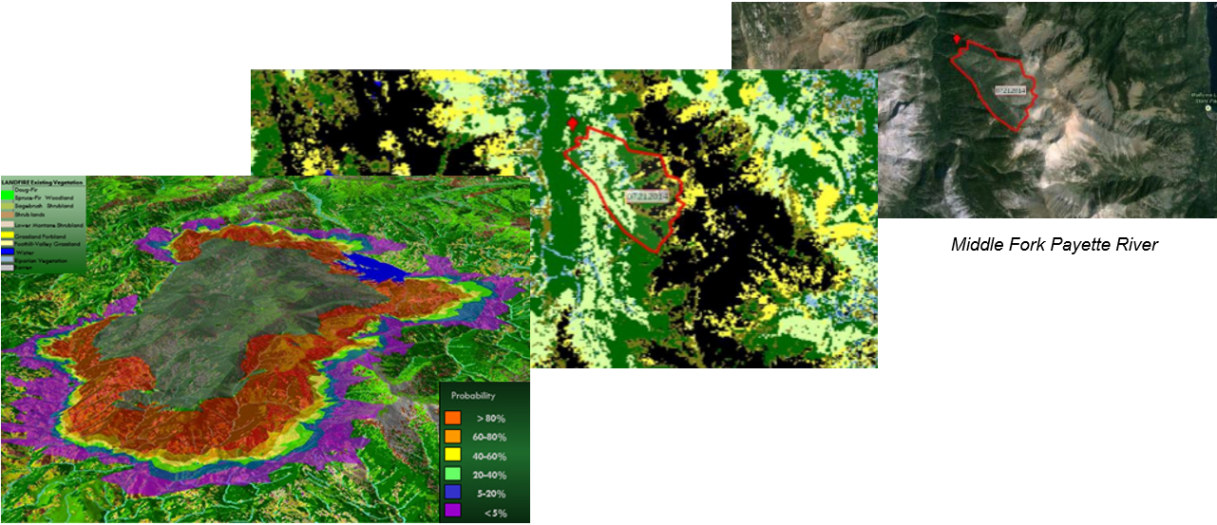
Data Use Examples – Decision Support
Why is it
Important?
WFDSS – Wildland Fire Decision Support System
Fire managers and analysts use LANDFIRE data in strategic and tactical decisions for fire incidents and
line officers review and make decisions
Fuel layer editing
Fire behavior analysis
Notes:
LANDFIRE data used in the Wildland Fire Decision Support System (WFDSS) showing how data and the model is used to help managers with tactical and strategic decisions.
Images:
Wildland Fire modeling and progression mapping in WFDSS

Slide 28
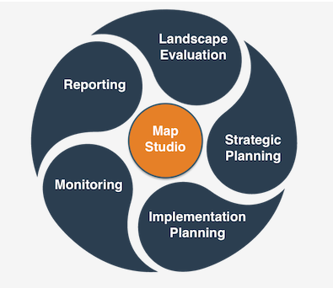
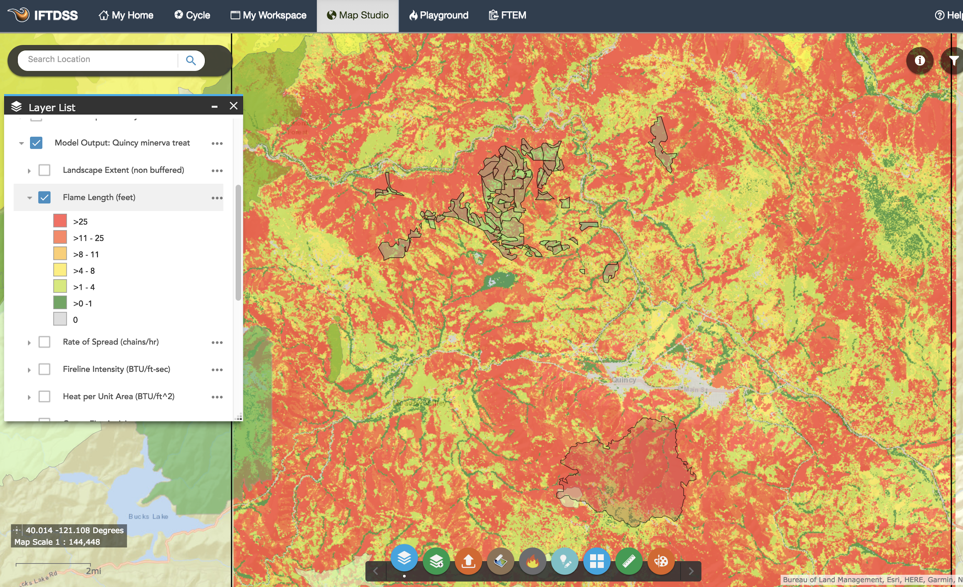

Why is it
Important?
Flame Length Modeling without accounting for Changes due to Fuels Treatments or Wildfire
Proposed Mechanical Thinning Fuels Treatment
Landscape Fire Behavior run at 97th percentile weather using the closest RAWS station (Quincy, CA.)
Quincy
2017 Minerva Wildfire
Proposed Treatment
Mechanical Thinning:
Reduce Canopy Cover
Reduce Canopy Density
Increase Canopy Base Height

Slide 29

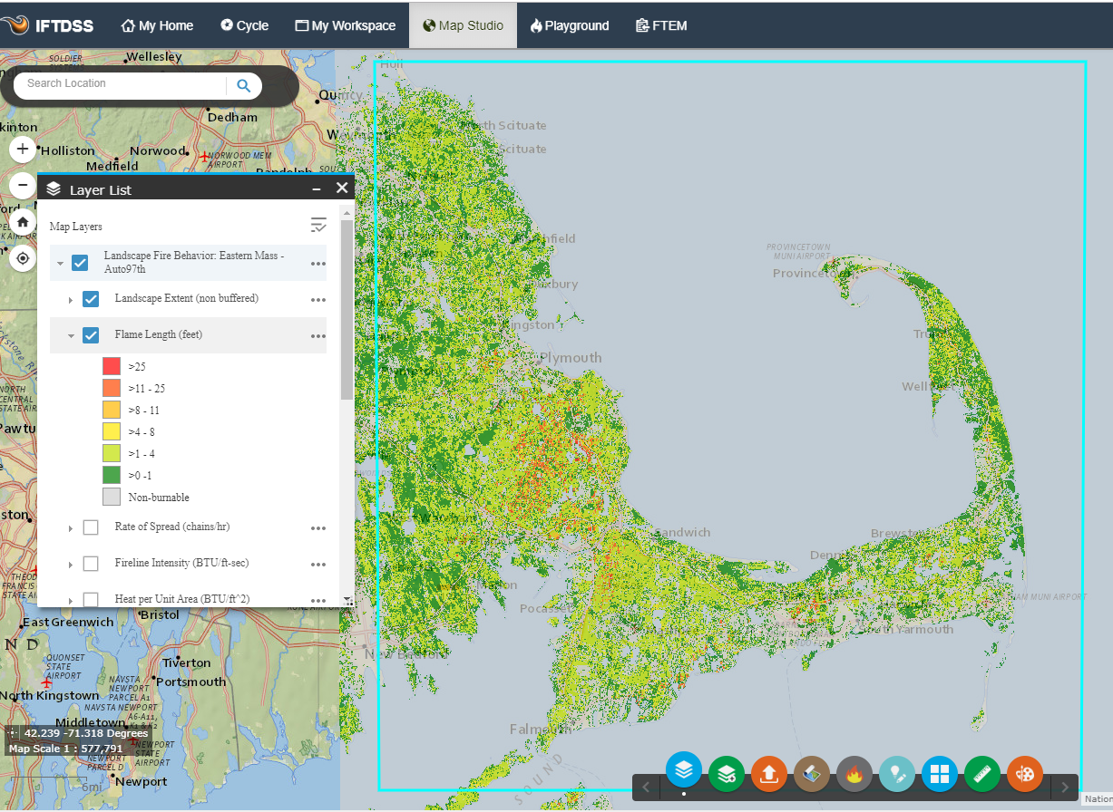

Model fire behavior across large landscapes: Landscape Fire Behavior at the pixel level (FLAMMAP)
Notes:
Map based outputs for all fire behavior model outputs.
Inputs show on right.

Slide 30



Model fire behavior across large landscapes: Landscape Burn Probability (FLAMMAP)
Notes:
2 models currently.
Last slide was pixel based fire behavior. (Landscape Fire Behavior –FLAMMAP Basic
This slide is burn probability based on worst case conditions single weather scenario that the user specifies themselves. – Landscape Burn Probabilty – FLAMMAP RANDIG (MTT run thousands of times)

Slide 31




Integrated Hazard - Comparison
Why is it
Important?
IFTDSS & Quantitative Wildfire Risk Assessment
Communities (WUI)
High
Mod.
Low
Mean Conditional Flame Length
Low Mod. High
Mean Burn Probability
Ecosystem Function
 | Existing Conditions |  | Treated
HVRA | Mean BP | Mean CFL | Mean BP | Mean CFL
Infrastructure | 0.0230 | 8.2 | 0.0199 | 7.6
Communities | 0.0286 | 11.1 | 0.0233 | 9.7
Air Quality | 0.0278 | 11.9 | 0.0230 | 10.8
Drinking Water | 0.0271 | 12.0 | 0.0227 | 10.8
Ecosystem Function | 0.0278 | 11.7 | 0.0230 | 10.7
High
Mod.
Low
Mean Conditional Flame Length
Low Mod. High
Mean Burn Probability
Existing conditions Treated

Slide 32

Performance Measures
Why is it
Important?

Slide 33


Why is it
Important?
Non-fire examples / applications
Supporting the mission -------

Slide 34




DOI Fire Budget - Greenbook
Budget?
Notes:
Because responding to wildfire is interagency in nature, Wildland Fire has a separate annual Budget Justification

Slide 35
Budget History
Budget?
FIREPRO
  many resources and values were non-market and difficult to quantify in dollars
  Use by NPS and FWS
National Fire Management Analysis System (NFMAS)
  Most Efficient Level {percentage breakouts}
  Use by BIA, BLM, USFS
FPA - (Fire Program Analysis)
  Retired / Transition components into WFIPS (Wildland Fire Investment Planning System) at FS Firelab.
Recent DOI
  Risk Based Wildland Fire Management (RBWFM)
    Aligned with current state of wildfire risk science
  Expected Value Acres Burned (EVAB)
    geo-analysis process and modeling
  Deputy Secretary Connor Memo
Notes:
Budget History

Slide 36

DOI Fire Budget - Greenbook
Budget?
Notes:
First thing that you notice about the GB language – does not discuss funding by bureau, but rather by subactivity.
This further reinforces the interagency nature of fighting fire
Preparedness – Being ready to provide an appropriate response to wildland fires
Suppression Operations – response to wildfires. Also includes pre-suppression activities (Severity) and post-suppression activities (ES)
Fuels Management – Reduce hazardous fuels and risks to human communities by creating fire-resilient landscapes and restoring fire- adapted ecosystems
BAR – Long term actions to repair lands unlikely to recover naturally from severe wildfire damage

Slide 37

Preparedness Allocations by Bureau
Budget?
Notes:
Prep allocations for context

Slide 38

Fuels Allocations by Bureau
Budget?
Notes:
Fuels allocations for context

Slide 39
Forest Service Fuels Allocation
Budget?
Fire and Aviation Management (FAM) is part of State And Private Forestry (S&PF)
Fire Funding includes:
  Suppression
  Prevention
  Preparedness
  Hazardous Fuels for NFS lands
    Transferred to states for treatment of non-FS lands
S&PF Grants
  State Fire Assistance (SFA)
  Volunteer Fire Assistance (VFA)

Slide 40
How Does LF influence Budget?
Budget?
Terms you may hear:
  Fireshed or Fireshed Registry
  Quantitative Wildfire Risk Assessment (QWRA)
  Wildfire Risk to Communities (wildfirerisk.org)
  Wildfire Hazard Potential (WHP)
  Strategic Investment Planning
All these processes use some form of LANDFIRE data. National applications – LF data is out-of-the-box. For local use, the LF data is often calibrated first.
Shared Stewardship = an agreement between state government and the federal government to share data, resources, and priorities to better coordinate actions.
USDA - Evidenced-Based Decision-Making

Slide 41
FS Hazardous Fuels Allocation
From Washington Office to the Regional Offices to the Forest Unit Offices
FireShed Registry

Slide 42


Wildfire Risk to Communities
www.wildfirerisk.org
  You can set scale to state or national

Slide 43

LANDFIRE Annual Disturbance Mapping
Annual Update Planning - Example
Future?
Notes:
IMAGE ON LEFT
For instance, the red areas in the image were identified as likely vegetation change based on dDNBR (Differenced Normalized Burn Ratio) and MIICA (Multi-Index Integrated Change Analysis)
• The blue areas in the image were identified as vegetation change based upon long-time horizon NDVI (Normalized Difference Vegetation Index) and regression modeling techniques
• MIICA and dNBR are more likely to falsely identify Landsat 7 SLC (and other) gaps as change
• Image analysts work at length and consider all information sources to identify true change and separate it from falsely detected change
IMAGE ON RIGHT:
In the scenario presented here, MIICA and other change products (i.e., dNBR) detect change by differencing derivative data produced from the image composites (i.e., NBR) for successive years
• This can result in falsely identified changes in areas where there are data gaps or phenological differences (e.g., leaf-on vs leaf-off)
• The NDVI products, on the other hand, leverage every imagery over the entire year and modeling techniques ignore the no-data pixels
• The NDVI and modeling methods have proven beneficial at reducing the number of false change detections that differencing techniques like dNBR cannot

Slide 44

LANDFIRE Webinar
LANDFIRE Remap for the Northeastern United States
Webinar focused on the NE with the Forest Guild
October 21, 2020
Notes:
On behalf of the TNC LANDFIRE Team and the entire LANDFIRE Program, I thank you for the opportunity to present this webinar describing the status and plans for the LANDFIRE Program.

Slide 45
NE – Wildland Fire Management Tools – Fall 2020:
AGENDA:
What is it?
Why it’s important
Budget (use and not used)
NE Remap and future
LANDFIRE
Landscape Fire and Resource Management Planning Tools Project
  Comprehensive
  Consistent
  Compatible
  Current

